Slide 1

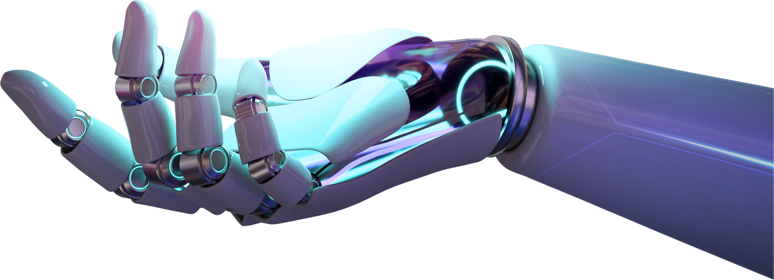
TX2IMG
Home
About
Content
Others
Advanced Text-to-
Image Generation
Welcome to the New Era
Generative Ai
-
SHR1_AIS2_M1e
-
Page 01

Slide 2

TX2IMG
Home
About
Content
Others
ABOUT US
We are a dedicated team of engineers and AI experts exploring the new era of Generative AI. We chose the exciting field of Text-to-Image generation due to its vast potential.
This technology can transform textual descriptions into vivid images, opening up applications in various fields, from creative industries to engineering solutions. By harnessing Generative AI, we aim to revolutionize communication and innovation in the digital age.
Generative Ai
-
SHR1_AIS2_M1e
-
Page 02

Slide 3
TX2IMG
Home
About
Content
Others
OUR VISION
Innovation: Continuously improve and implement cutting-edge AI technologies to enhance the realism and applicability of generated images.
01
Impact: Drive substantial advancements in various sectors by integrating powerful text-to-image solutions that streamline processes and foster creativity.
02
Our vision is to lead the transformation of Text-to-Image Generation, setting new standards in the industry through relentless innovation, practical applications, and widespread accessibility
Excellence: Commit to excellence by fostering a collaborative environment where innovation thrives, and diverse talents come together to achieve extraordinary results.
03
Generative Ai
-
SHR1_AIS2_M1e
-
Page 03

Slide 4
TX2IMG
Home
About
Content
Others
OUR MISSION
Empowerment: Equip industries with intuitive AI tools that simplify the process of converting text to images, making complex concepts easier to understand
01
Innovation: Continually improve our models and methodologies to produce more realistic and applicable results, ensuring our solutions remain at the forefront of technology.
02
Our mission is to explore and enhance Text-to-Image Generation technologies, providing practical and innovative solutions to visualize and interact with data more effectively.
Practicality: Focus on delivering user-friendly, accessible, and robust text-to-image applications that can be readily adopted in various fields
03
Generative Ai
-
SHR1_AIS2_M1e
-
Page 04

Slide 5
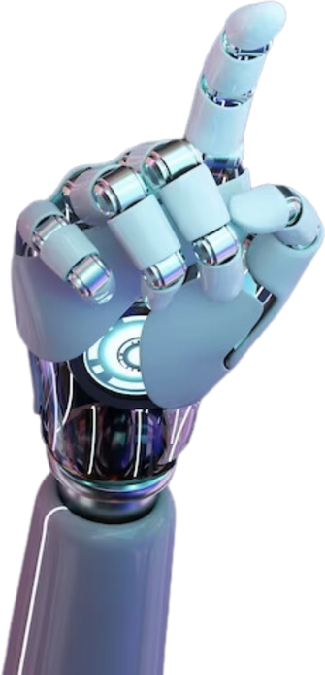
TX2IMG
Home
About
Content
Others
PROCESS
Data Collection and Preprocessing :
Collected a dataset of images and corresponding text descriptions.
Preprocessed the data by resizing images and
normalizing text to ensure consistency and quality.
Generative Ai
-
SHR1_AIS2_M1e
-
Page 05

Slide 6
TX2IMG
Home
About
Content
Others
PROCESS
2.Model Development and Training
Used advanced models like GPT2 for text processing and Stable Diffusion for image generation.
Trained the model to understand and generate
accurate images from textual prompts.
Generative Ai
-
SHR1_AIS2_M1e
-
Page 05

Slide 7
TX2IMG
Home
About
Content
Others
PROCESS
3.Advanced Techniques and Integration
Integrated cutting-edge techniques such as guidance scale and increased inference steps to enhance the realism and detail of the generated images.
Utilized tools like transformers and diffusers libraries to streamline the development process.
Generative Ai
-
SHR1_AIS2_M1e
-
Page 05

Slide 8
TX2IMG
Home
About
Content
Others
PROCESS
4.Deployment and MLOps
Implemented MLflow for tracking experiments, models, and metrics to ensure reproducibility and continuous improvement.
Deployed the final model, making it accessible for various applications across industries.
Generative Ai
-
SHR1_AIS2_M1e
-
Page 05

Slide 9
TX2IMG
Home
About
Content
Others
PROCESS
5.Evaluation and Refinement
Continuously evaluated the performance of the model, gathering feedback to make iterative improvements.
Applied post-processing techniques to further enhance the quality of the generated images.
Generative Ai
-
SHR1_AIS2_M1e
-
Page 05

Slide 10
TX2IMG
Home
About
Content
Others
ACHIEVEMENT
Our code achieves several significant milestones in the realm of Generative AI and Text-to-Image technology:
Implementation of Advanced Models: Utilizes cutting-edge models like GPT-2 for text processing and Stable Diffusion for image generation, showcasing the integration of state-of-the-art AI technologies.
Generative Ai
-
SHR1_AIS2_M1e
-
Page 08

Slide 11
TX2IMG
Home
About
Content
Others
ACHIEVEMENT
Our code achieves several significant milestones in the realm of Generative AI and Text-to-Image technology:
Realistic Image Generation: By employing techniques such as increased inference steps and guidance scales, the code generates detailed and realistic images from textual descriptions, pushing the boundaries of current capabilities.
Generative Ai
-
SHR1_AIS2_M1e
-
Page 08

Slide 12
TX2IMG
Home
About
Content
Others
ACHIEVEMENT
Our code achieves several significant milestones in the realm of Generative AI and Text-to-Image technology:
User-Friendly Integration: The code is designed to be accessible and user-friendly, demonstrating the practical application of complex AI models in generating high-quality images. This makes it easier for users to harness the power of Generative AI without needing extensive technical expertise.
Generative Ai
-
SHR1_AIS2_M1e
-
Page 08

Slide 13
TX2IMG
Home
About
Content
Others
ACHIEVEMENT
Our code achieves several significant milestones in the realm of Generative AI and Text-to-Image technology:
Enhanced Workflow Efficiency: Through effective data preprocessing and model integration, the code streamlines the workflow from text input to image output, highlighting the efficiency and potential of AI in transforming data visualization.
Generative Ai
-
SHR1_AIS2_M1e
-
Page 08

Slide 14
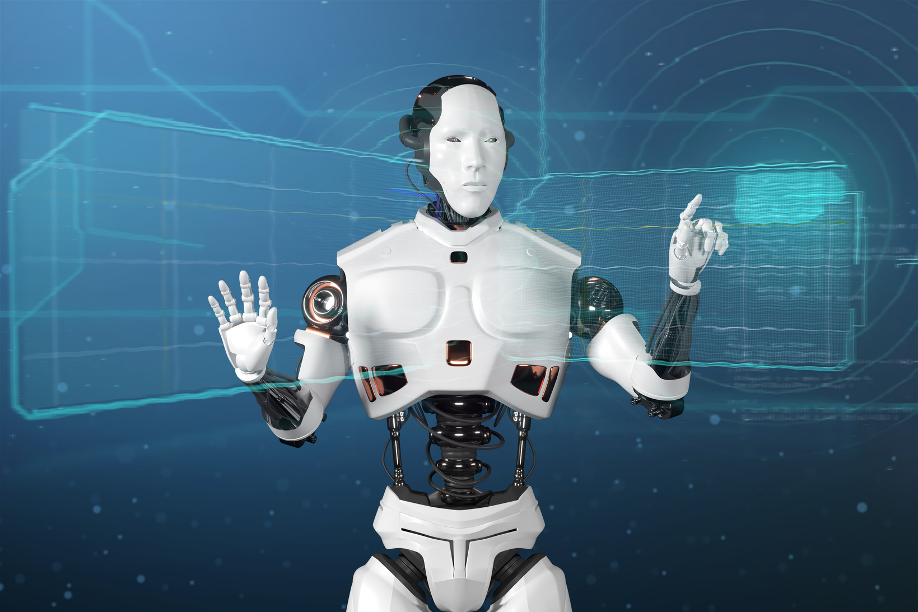
TX2IMG
Home
About
Content
Others
GOALS
Our goal is to develop advanced techniques that enhance the accuracy of text-to-image generation. By expanding the practical applications across various fields and ensuring user-friendly accessibility, we aim to push the boundaries of Generative AI technology, fostering continuous innovation and making powerful AI tools available to a broad audience
Presentations are communication tools that can be used as demonstrations, lectures, speeches, reports, and more.
Generative Ai
-
SHR1_AIS2_M1e
-
Page 06

Slide 15
TX2IMG
Home
About
Content
Others
THANK YOU
ARTIFICIAL INTELLIGENCE PRESENTATION
Generative Ai
-
SHR1_AIS2_M1e
-
Page 09

